Slide 1
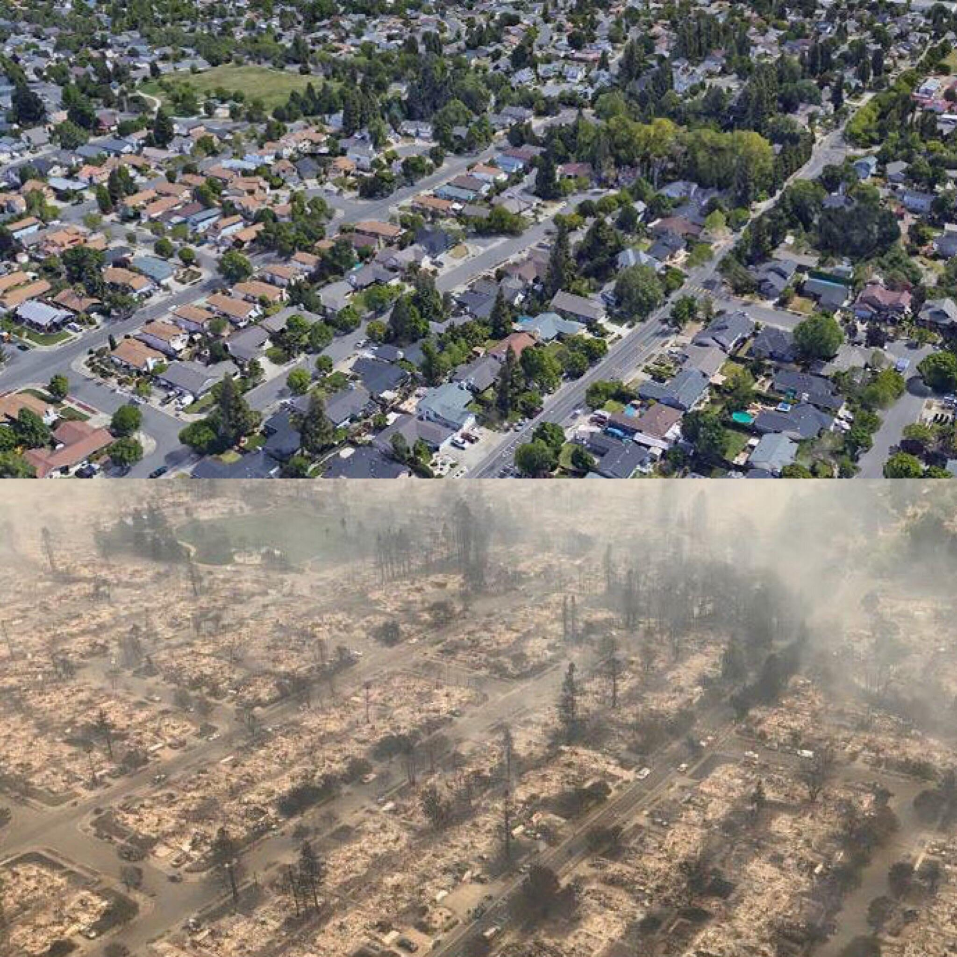

What if you had used our forest fire prediction model ?
Santa Rosa from Northern California fires

Slide 2
Challenge 1 : Fire mapping
CY Fire team
Ordronneau Luca
Reberga Louis
Moncoutie Johan
Ettarian Julian

Slide 3
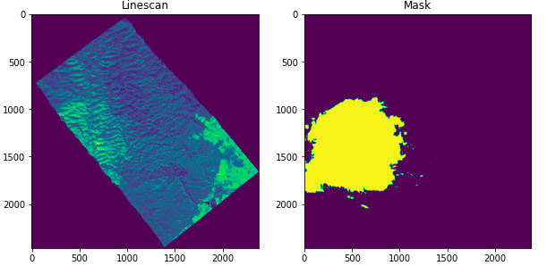
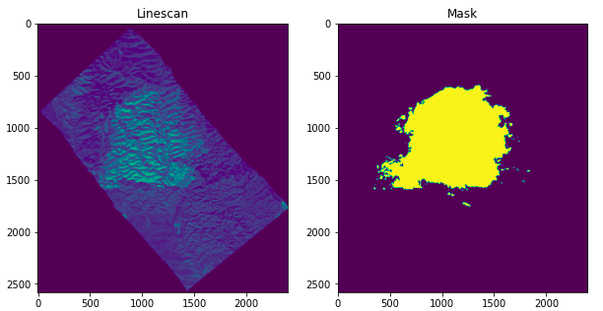
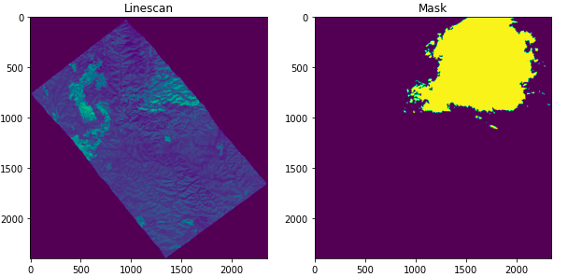
Match composite polygons
'COMPOSITE_WALLHALLA_397,398_&_401_20190225_(1311_TO_1342HRS)’
Algorithm
[397, 398, 401]
Algorithm
['WALHALLA_397_P1_201902251311_MGA94_55', 'WALHALLA_398_P1_201902251323_MGA94_55', 'WALHALLA_401_P1_201902251342_MGA94_55']

Slide 4
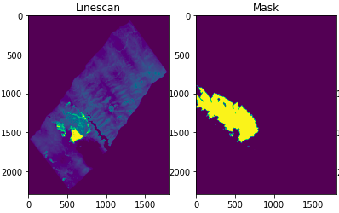
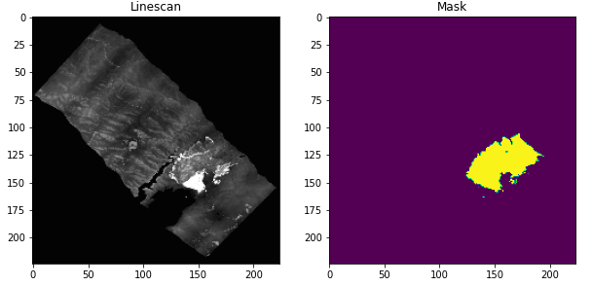
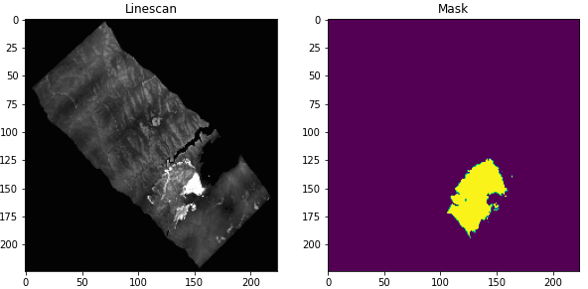
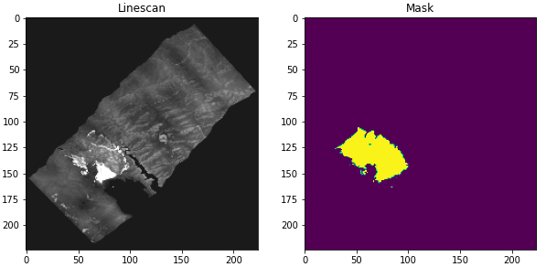
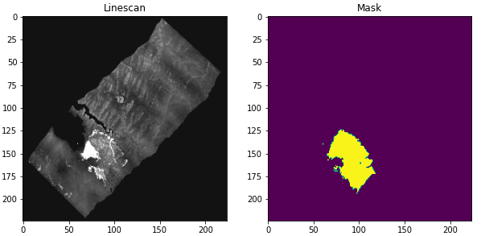
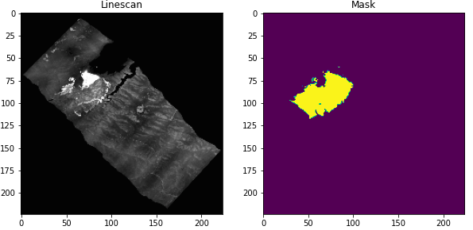
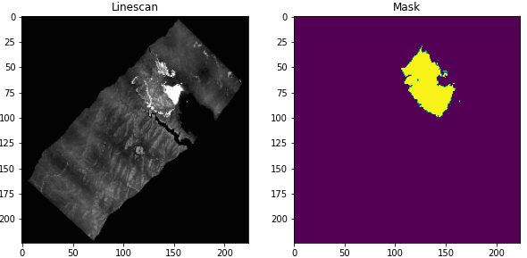
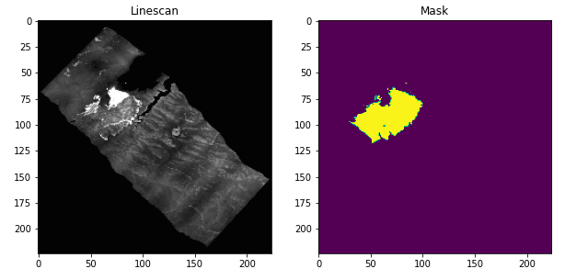
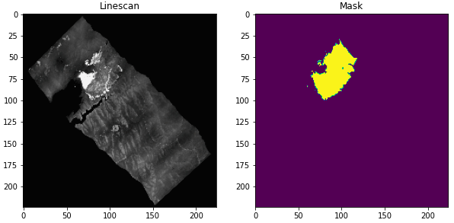
Pre Processing
Resize
Gaussian Filter
Normalisation
Image Augmentation
Mask modification
CLAHE

Slide 5
Model
Unet (F1 score ~ 0.45 - 0.50)
Benefits
Using a pre-trained encoder helps the model to converge much faster in comparison to the non-pretrained model.
A pre-trained encoder helps the model to achieve high performance as compared to a non pre-trained model.
Unet with Pretrained ResNet50 Encoder (F1 score ~ 0.65 - 0.70)
Unet with Pretrained InceptionResNetV2 Encoder (F1 score ~ 0.70 - 0.73)

Slide 6
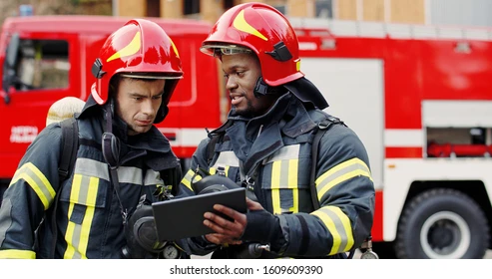
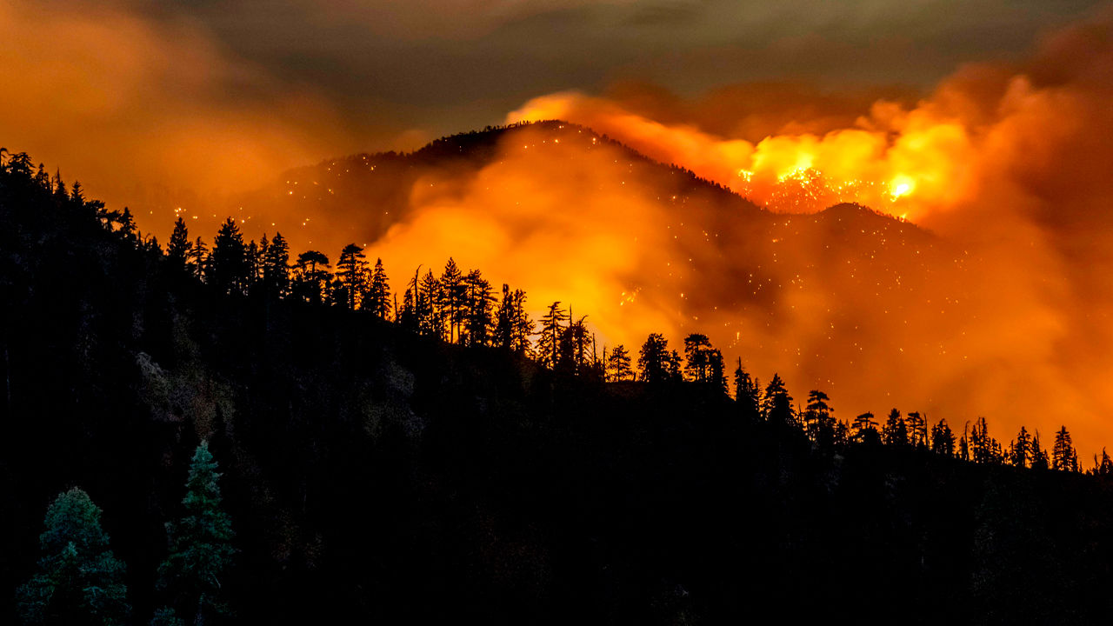

Improve society's resilience to bushfires
24/7 surveillance
Help firefighters react faster
Prevent human and material losses

Slide 7
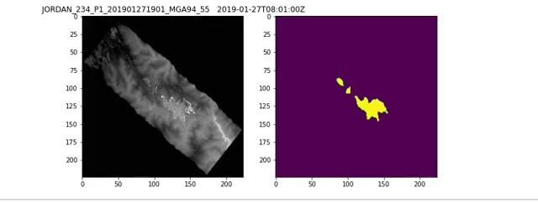
Results

